Slide 1
MULTIPLE BREAK REBAR
Advisor : Prof. K.C.Chang
Presenters : You-Ran Nai

Slide 2
OUTLINE
QUESTION REPLY
PAPER PROGRESS
PAPER REVIEW

Slide 3
Incremental Dynamic Analysis with Multi-Modes for Seismic Performance Evaluation of RC Bridges
Prakit Chomchuen, Virote Boonyapinyo
Engineering Structures
February 2017

Slide 4
AUTHOR
UNIVERSITY
Prakit Chomchuen, Virote Boonyapinyo
Department of Civil Engineering, Faculty of Engineering, Thammasat University, Rangsit Campus, Klong Luang, Pathumthani 12120, Thailand
Notes:
法政大學

Slide 5
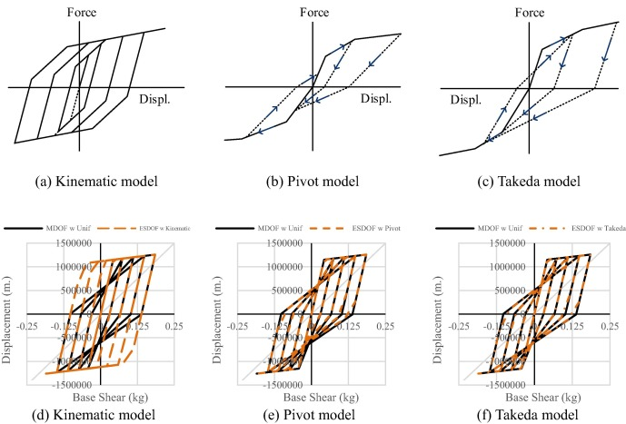
HYSTERESIS
AUTOMATICALLY GENERATED BY
THE PROGRAM
Notes:
遲滯迴圈的模擬用程式內建的參數並不太準
對，paper 是使用模型自動產生的參數
這部分因為之前都沒看過，還要多看 paper 補齊這方面的知識
王柄雄學長

Slide 6
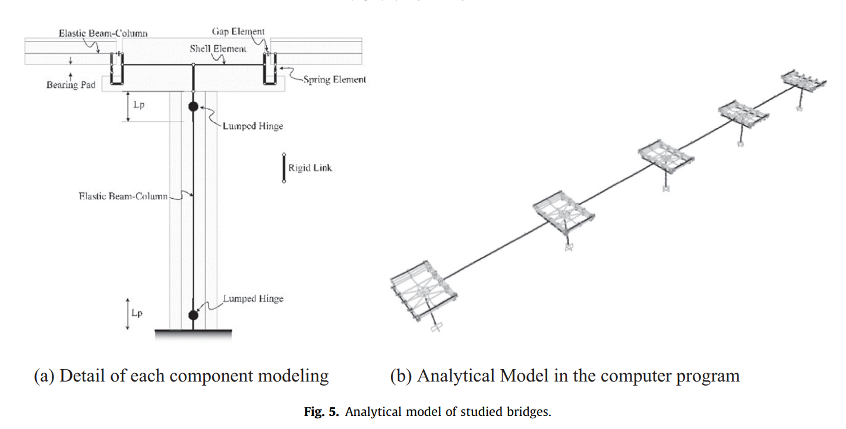
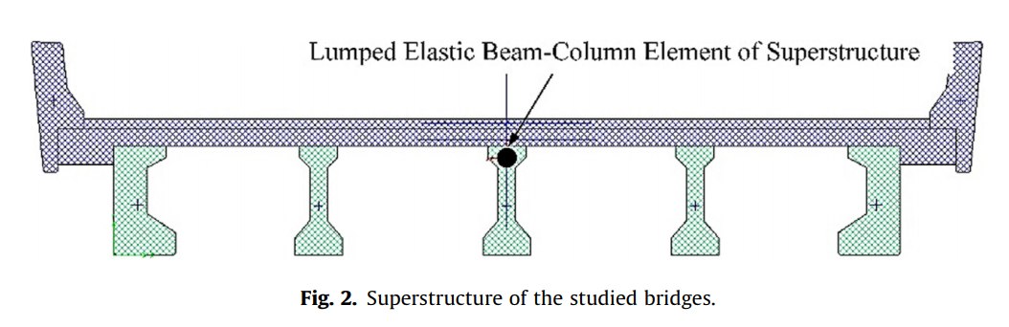
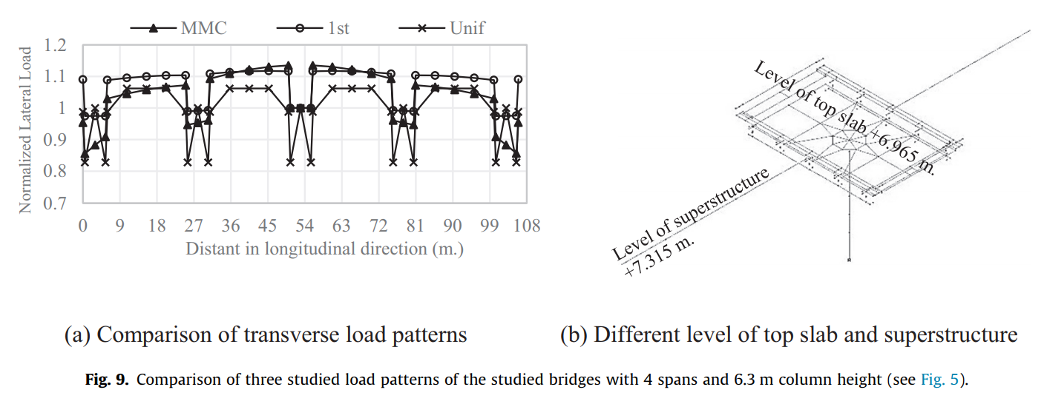
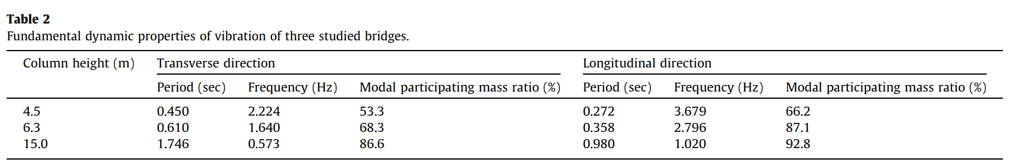
THREE BRIDGES
4 spans, 6.3m column height

Slide 7
OUTLINE
QUESTION REPLY
PAPER PROGRESS
PAPER REVIEW

Slide 8
LINEAR - FROM EXISTING REBAR
1
2
3
4
5
MOMENT DIAGRAM
TENSION DEVELOPMENT LENGTH
GRAVITY DEMAND
LOAD PATTERN
REDUCE TO THREE / FOUR POINTS
Notes:
- 推估的演算法是用彎矩圖，上層筋以地震力，下層筋以重力與地震力進行多點斷筋。
- 並加上精算法的延伸長度。
- 手動輸入 Gravity 需求。(忽略帶寬、不平均)
- 手動輸入 Gravity 負彎矩偏差比例。Load Pattern Fix fix , fix pin , pin-fix , pin-pin
- 由無限斷筋縮減到有限點斷筋(3 點或 4 點) - 排列組合、分群演算法。

Slide 9
GRAVITY DEMAND
TOP LEFT
TOP RIGHT
LINEAR ADD
(EQ Demand)
(EQ Demand)
GRAVITY DEMAND
EQ DEMAND
BOT LEFT
BOT RIGHT
(EQ Demand)
(EQ Demand)
REVERSE ENGINEERING
➔ ACTUAL DEMAND
GIVEN INFORMATION
Notes:
像是 如果知道這條重力曲線的話
再加上四個配筋點
那其實很多曲線就可以逆推出來了
以上層筋為例
配筋點 – 重力 = 地震力
下層筋就直接是地震力
所以地震力和重力就出來了
那就可以回到前面的曲線
我們就可以直接 match 需求了

Slide 10
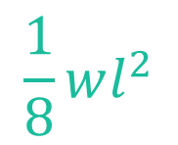
GRAVITY DEMAND
1/12
1/24
SDL LL 版厚 帶寬
1/24
0.9DL
$$\frac{1}{8}wl^{2}$$
1/12
0
1/8
1.2DL+1.6LL
Notes:
太保守了
算出來的反而比原本配的還多
但要怎麼知道這一條重力曲線呢
僅僅只有配筋梁長並不足夠
我們目前指定使用者手動輸入每層樓的
SDL LL 版厚 帶寬
這樣就可以用 $\frac{1}{8}wl^{2}算出$重力曲線
但只僅僅知道這個還不夠
重力需求曲線會隨著束制條件的不同而上下移動
如果都是 pin 兩端為 0
兩端是 fix 的話為 1/12
這個是比較不確定的地方
目前的想法是取保守估計
上層筋重力影響越少越好取 1/12 的一半 1/24
下層筋越多越好取 1/8
還要取載重組合
一樣上層越少越保守取 0.9DL
下層越多越保守取 1.2DL+1.6LL

Slide 11
CASE STUDY
GRAVITY
GRAVITY + EQ
➔
31.6
>
15.3

Slide 12
IDEAl CASE
1/12
1/12
1/24
1/24
1/24
1/24
0.9DL
➔
0.9DL
1/12
1/12
1.2DL+1.6LL
0
1/8
1/8
1.2DL+1.6LL

Slide 13
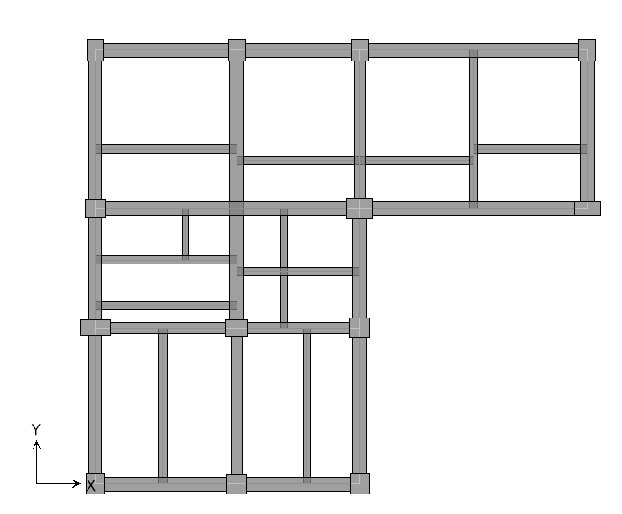
CASE STUDY - UNIFORM LOAD

Slide 14
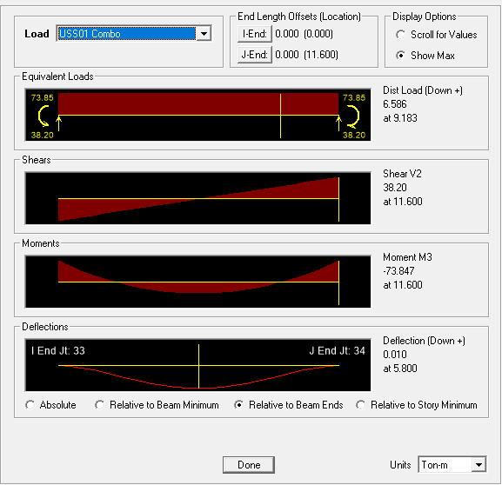
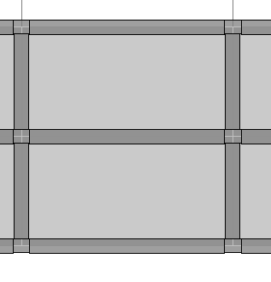
BEAM CONNECTION
MORE BEAMS CASE
TOP END: 74 t-m
BOT MID: 37 t-m

Slide 15
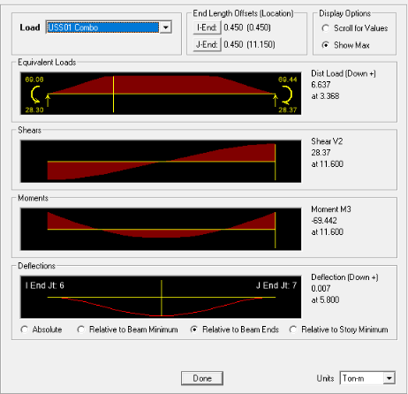
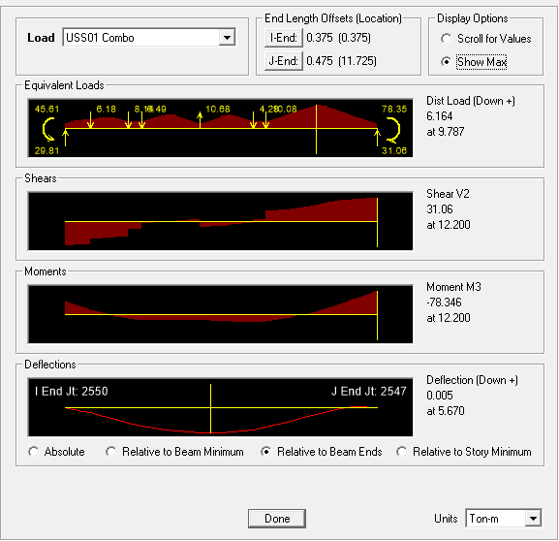
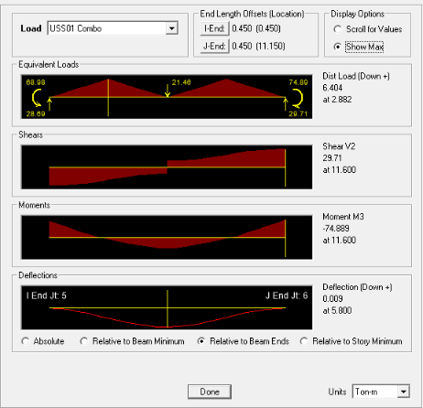
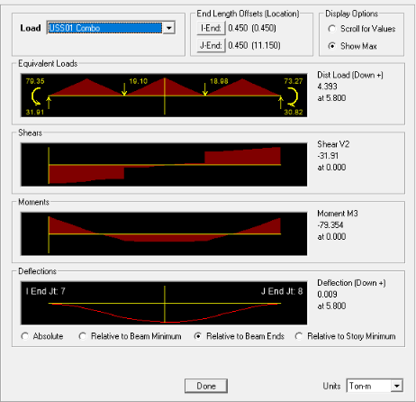
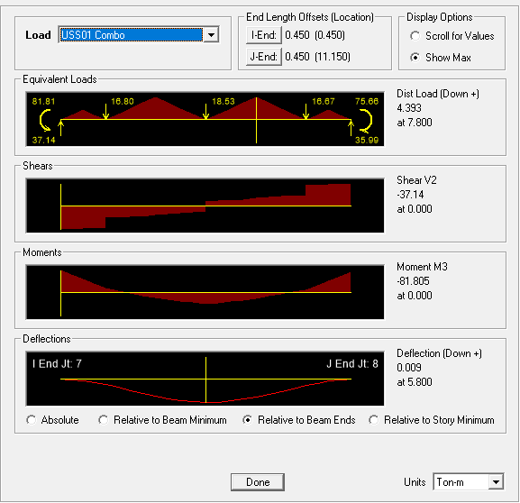
BENCHMARK
74 / 37
70 => 94%
32 => 86%
79 => 107%
22 => 60%
75 => 101%
44 => 119%
80 => 108%
34 => 92%
82 => 111%
41 => 111%
Notes:
均部載重？

Slide 16
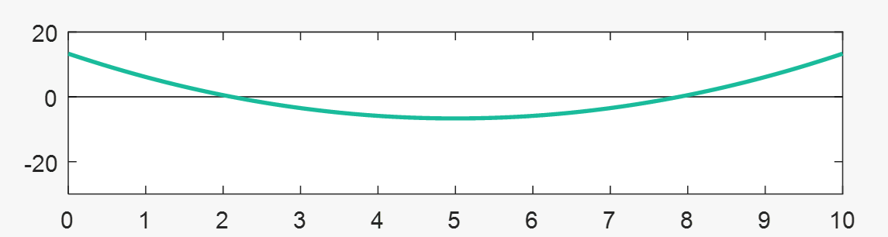
CONSERVATIVE
1/12
50%
1/24
1/24
200%
1/12
44 => 119%
70 => 94%

Slide 17
LINEAR - FROM EXISTING REBAR
1
2
3
4
5
MOMENT DIAGRAM
TENSION DEVELOPMENT LENGTH
GRAVITY DEMAND
LOAD PATTERN
REDUCE TO THREE / FOUR POINTS
Notes:
- 推估的演算法是用彎矩圖，上層筋以地震力，下層筋以重力與地震力進行多點斷筋。
- 並加上精算法的延伸長度。
- 手動輸入 Gravity 需求。(忽略帶寬、不平均)
- 手動輸入 Gravity 負彎矩偏差比例。Load Pattern Fix fix , fix pin , pin-fix , pin-pin
- 由無限斷筋縮減到有限點斷筋(3 點或 4 點) - 排列組合、分群演算法。

Slide 18
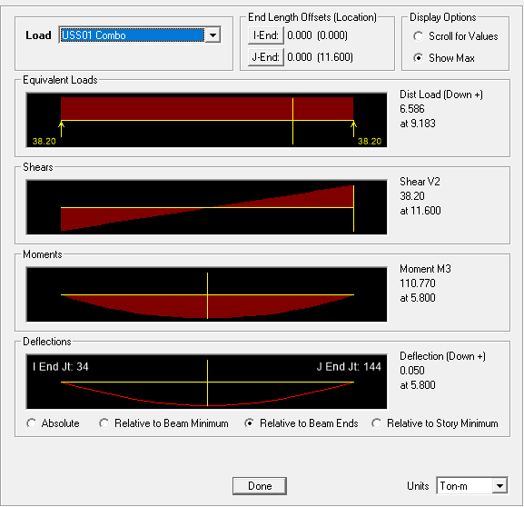
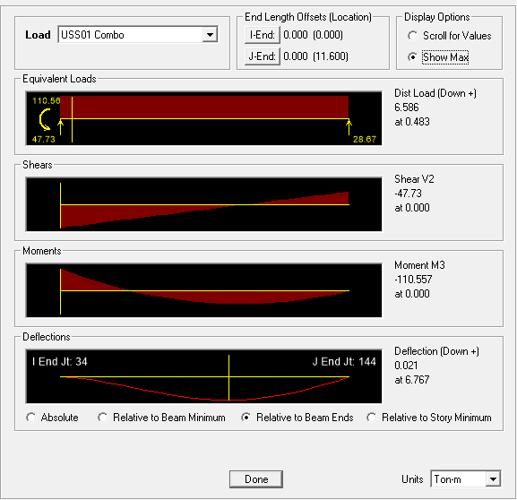
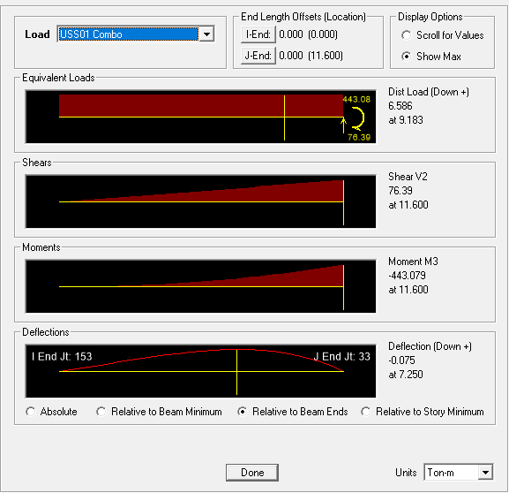
RESTRAINTS
Notes:
束制條件？
差異沉陷？

Slide 19
LINEAR - FROM EXISTING REBAR
1
2
3
4
5
MOMENT DIAGRAM
TENSION DEVELOPMENT LENGTH
GRAVITY DEMAND
LOAD PATTERN
REDUCE TO THREE / FOUR POINTS
Notes:
- 推估的演算法是用彎矩圖，上層筋以地震力，下層筋以重力與地震力進行多點斷筋。
- 並加上精算法的延伸長度。
- 手動輸入 Gravity 需求。(忽略帶寬、不平均)
- 手動輸入 Gravity 負彎矩偏差比例。Load Pattern Fix fix , fix pin , pin-fix , pin-pin
- 由無限斷筋縮減到有限點斷筋(3 點或 4 點) - 排列組合、分群演算法。

Slide 20
Roadmap
SHELVE
09/2018
2019
LOAD PATTERN
ETABS/SAP DEMAND
NONLINEAR TIME HISTORY ANALYSIS
DONE
NOW
12/2018
GRAVITY DEMAND
REDUCE TO THREE / FOUR POINTS
MULTI-MODES PUSHOVER

Slide 21
OUTLINE
QUESTION REPLY
PAPER PROGRESS
PAPER REVIEW

Slide 22
Incremental dynamic analysis
Dimitrios Vamvatsikos and C. Allin Cornell
EARTHQUAKE ENGINEERING AND STRUCTURAL DYNAMICS
2002
Notes:
Department of Civil and Environmental Engineering; Stanford University; CA 94305-4020; U.S.A.

Slide 23
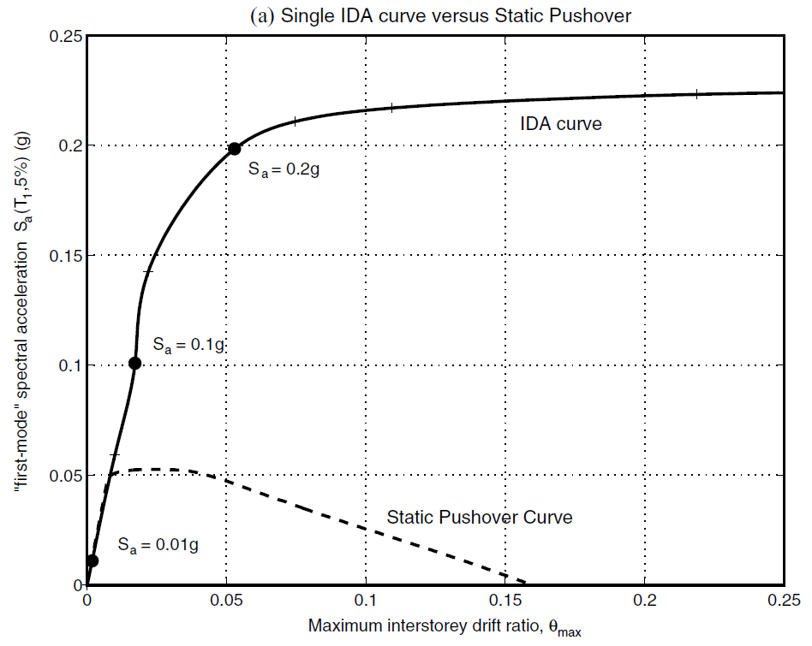
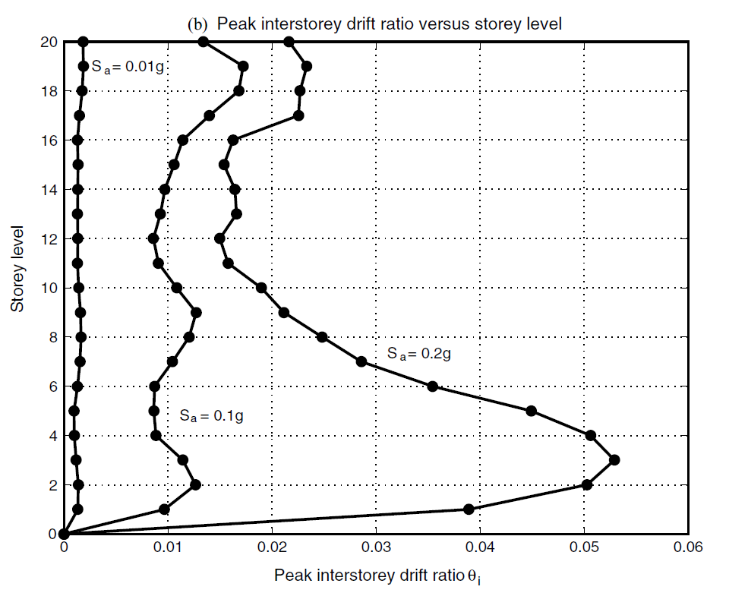
INTRODUCTION
SINGLE STATIC ANALYSIS
➔
INCREMENTAL SPO
SINGLE TIME-HISTORY ANALYSIS
➔
INCREMENTAL ONE

Slide 24
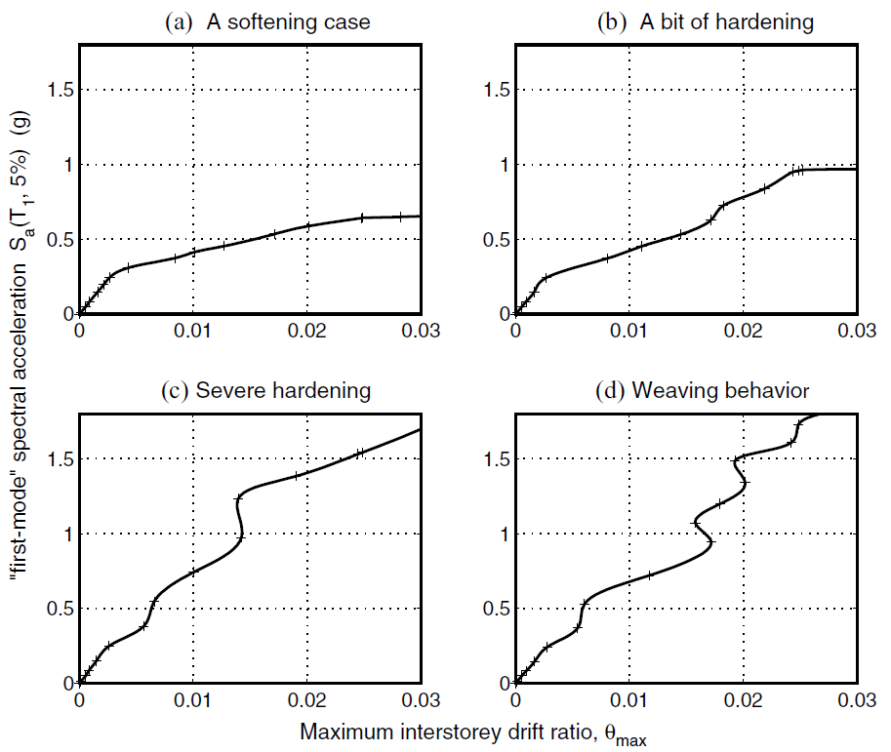
INFINITY
SOFTENS
0.2g
？
SOFTENING
&
HARDENING
EQUAL DISPLACEMENT
0.2g
Notes:
SOME GENERAL PROPERTIES

Slide 25
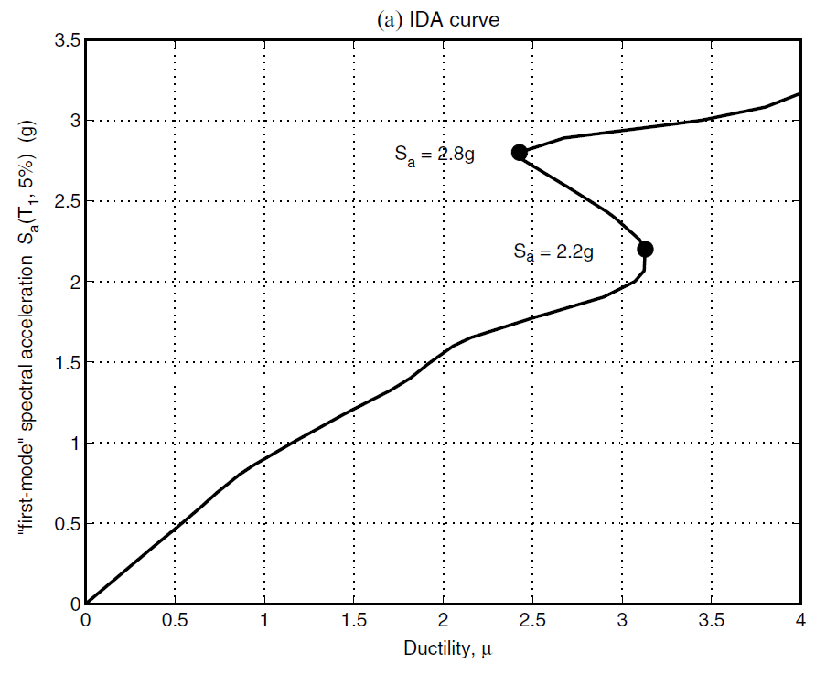
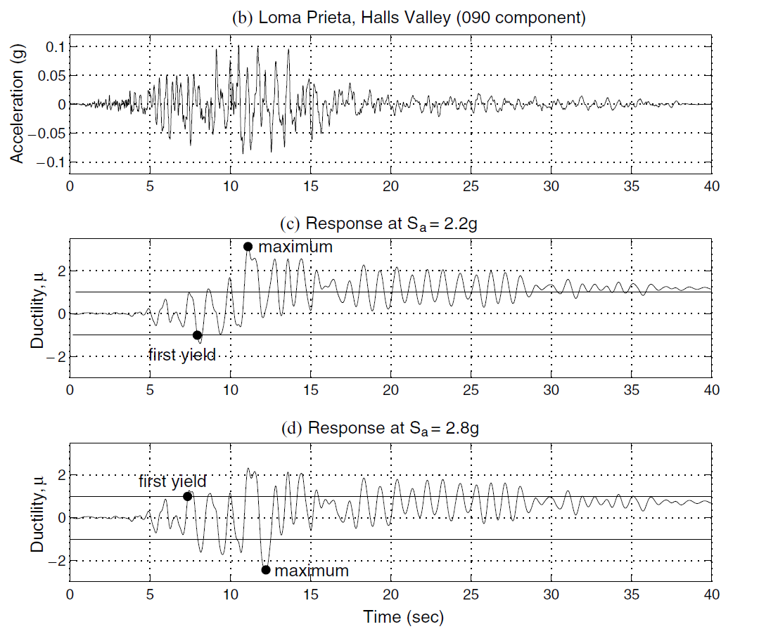
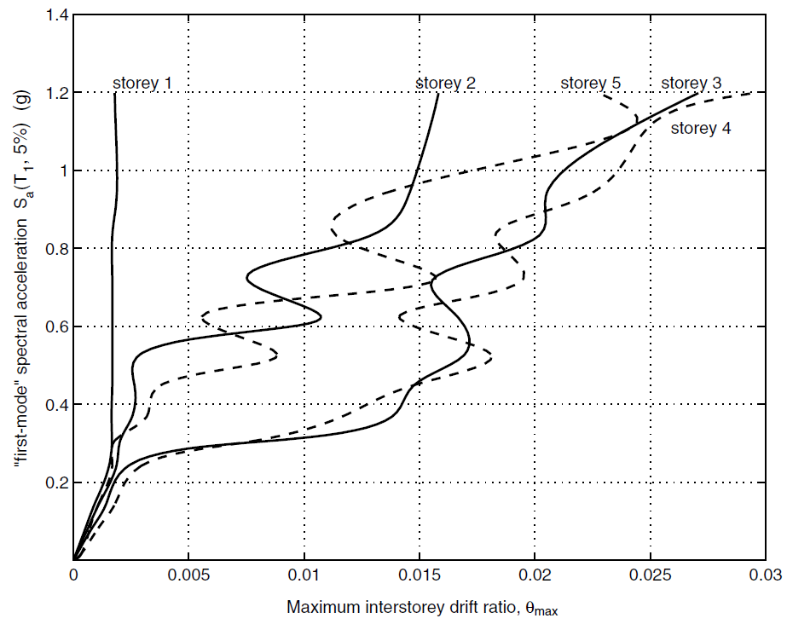
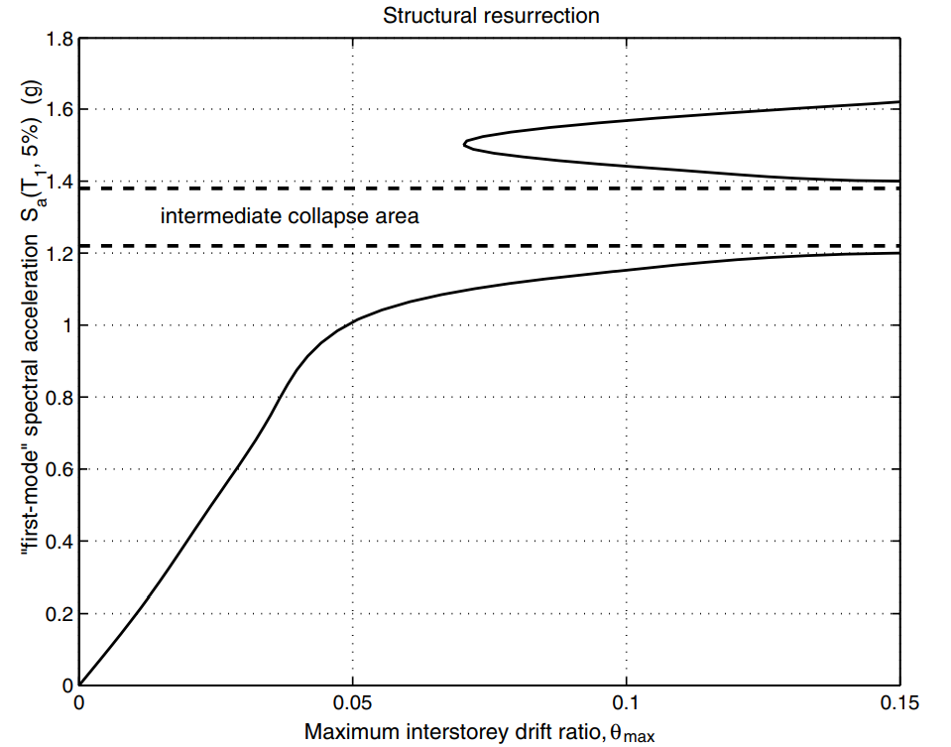
EARLIER YIELDING
FUSE
STRUCTURAL RESURRECTION

Slide 26
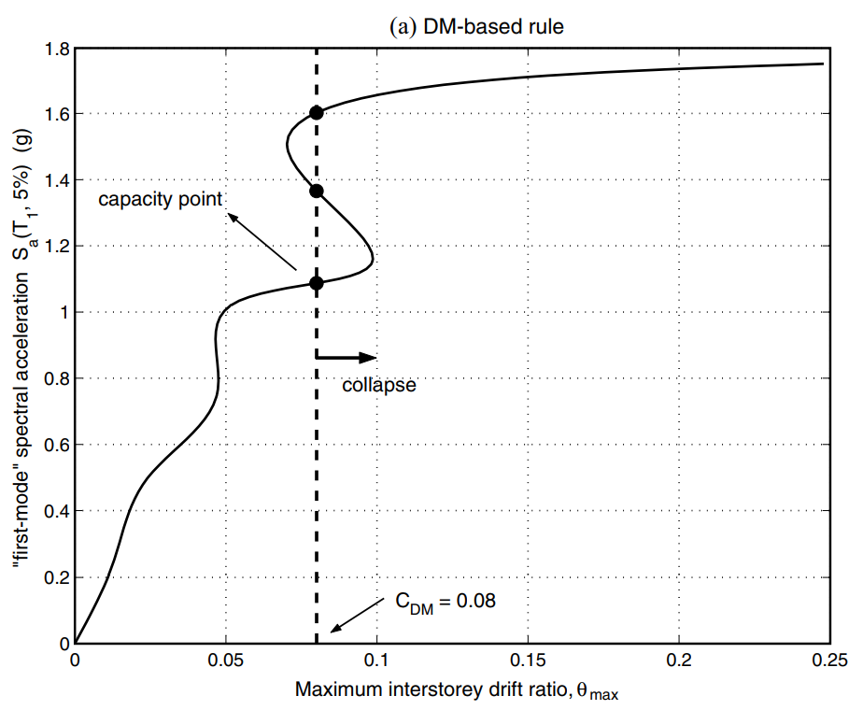
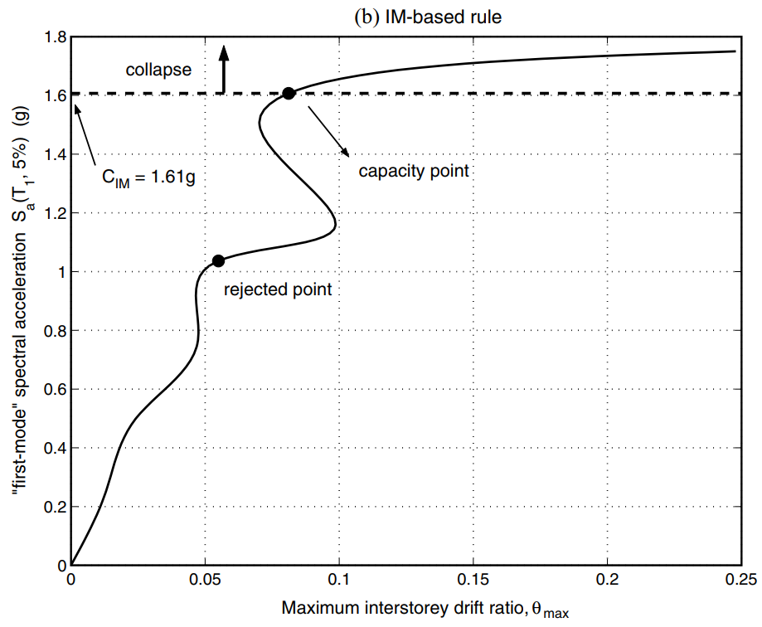
CAPACITY AND LIMIT-STATES
FEMA 20% TANGENT SLOPE APPROACH
Notes:
CAPACITY AND LIMIT-STATES

Slide 27
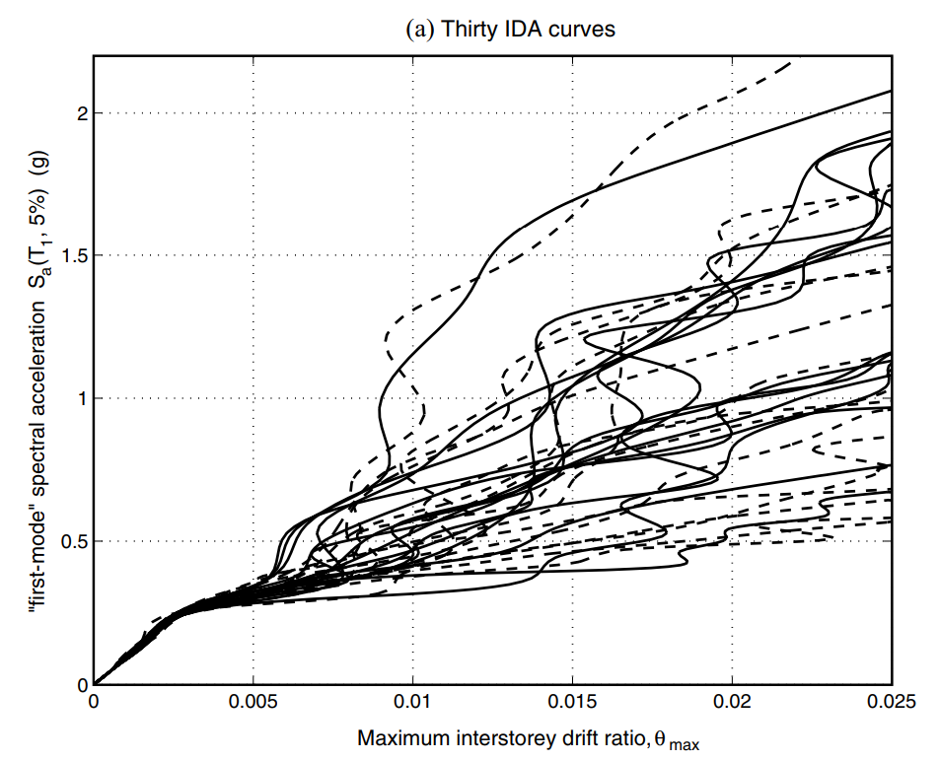


MULTI-RECORD
PARAMETRIC METHODS
NON-PARAMETRIC METHODS
MEAN
MEDIAN
CAPACITY

Slide 28




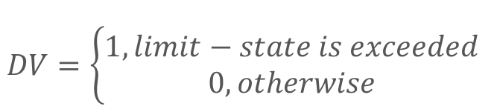

PBEE FRAMEWORK
$$DV=\left\{\begin{aligned}1, limit−state is exceeded \\ 0, otherwise\end{aligned}\right.$$
$$λ\left(IM\right): hazard curve$$
$$G\left(DM | IM\right):(conditional) complementary cumulative distribution$$

Slide 29
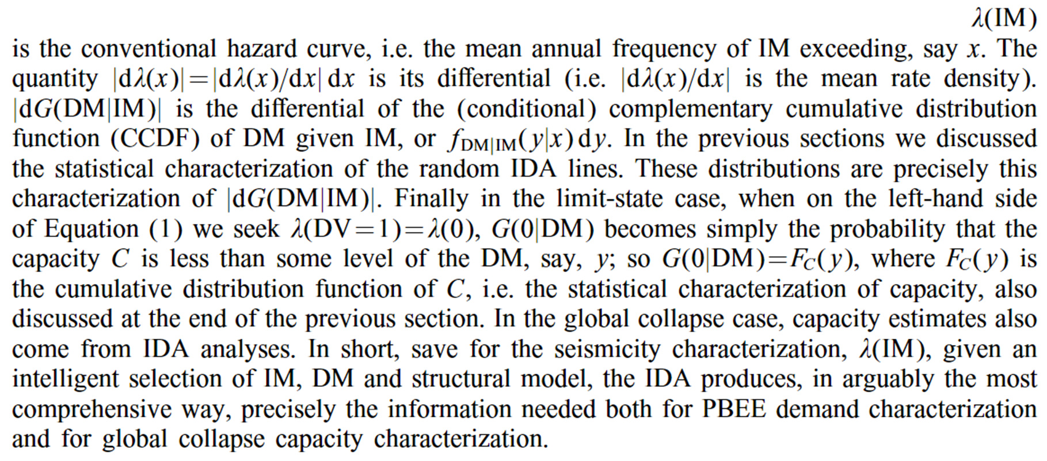

Slide 30
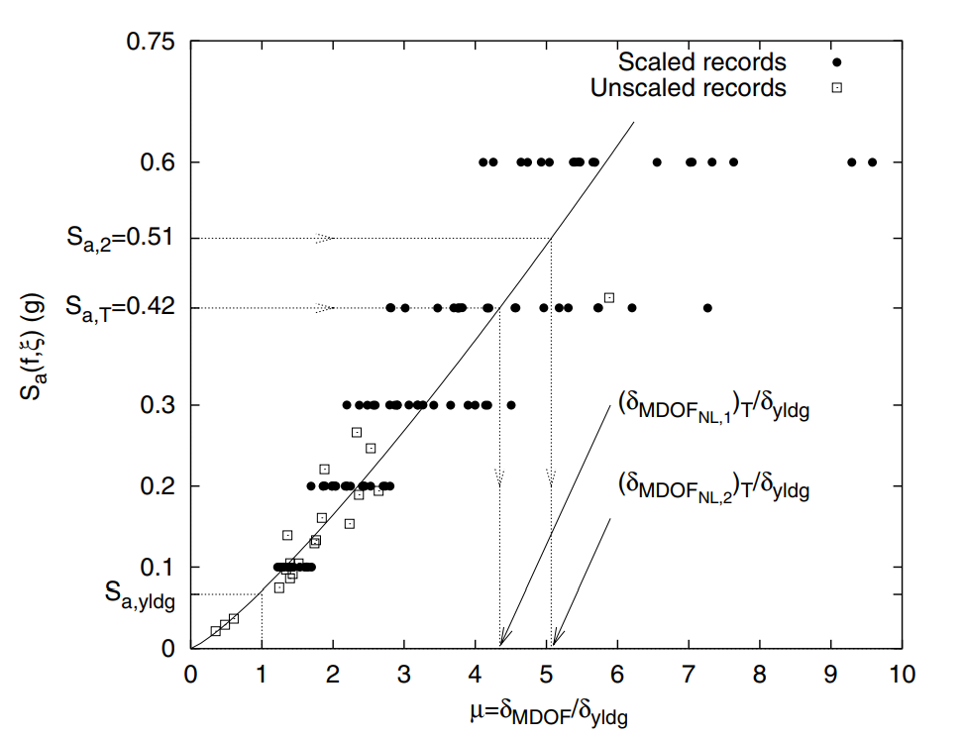
SCALING LEGITIMACY
ROOF DUCTILITY RESPONSE OF A
T₁= 1s
MDOF STEEL FRAME SUBJECTED TO
20 RECORDS
SCALED TO 5 LEVELS OF Sa(T₁,5%)

Slide 31
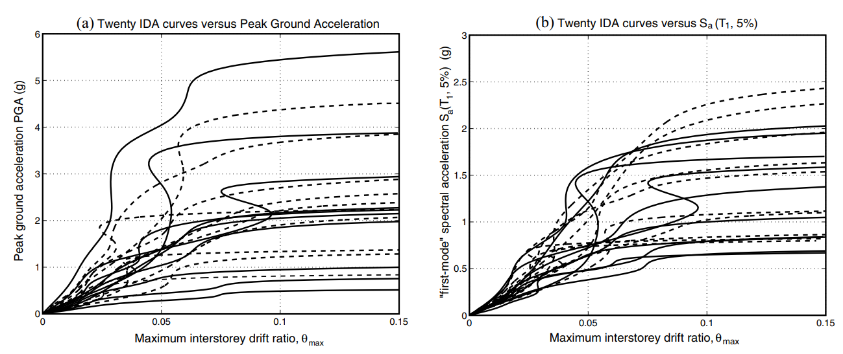
PGA
Sa(T₁,5%)

Slide 32
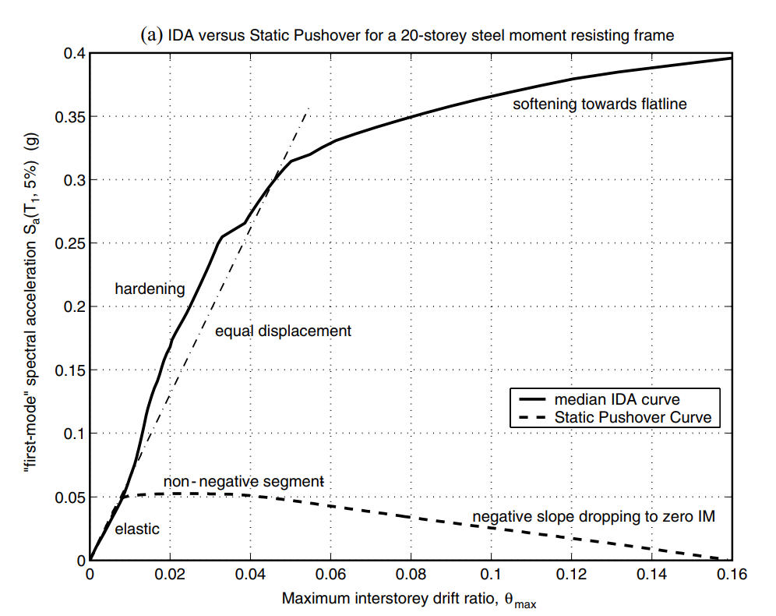
NON-LINEAR SPO
ELASTIC
➔
MATCH
NON-NEGATIVE
➔
EQUAL DISPLACEMENT
NEGATIVE
➔
SOFTENING

Slide 33
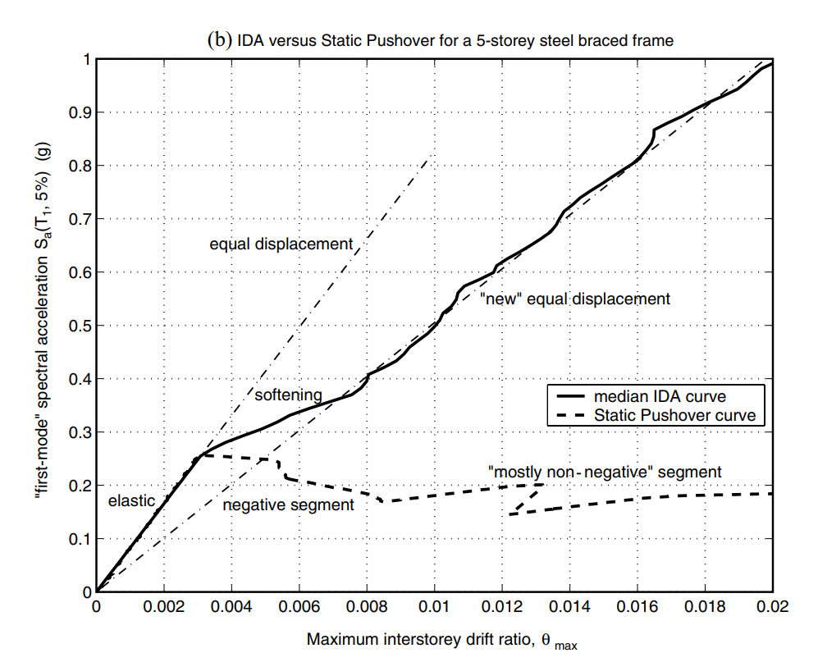
NON-LINEAR SPO
NEGATIVE => NON-NEGATIVE
NEW
EQUAL DISPLACEMENT
➔

Slide 34
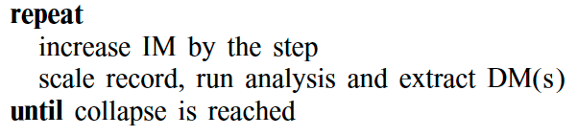
IDA ALGORITHMS

Slide 35
IDA ALGORITHMS
LESS POINTS
MORE POINTS

Slide 36
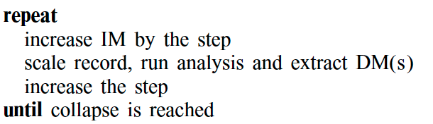
HUNT & FILL TRACING ALGORITHM
HUNTING PHASE

Slide 37
Furthermore, to improve upon the capacity resolution, a simple enhancement is to add a step-reducing routine, for example bisection, when collapse (e.g. non-convergence) is detected, so as to tighten the bracketing of the flatline.
FILL PHASE –
CAPACITY RESOLUTION

Slide 38
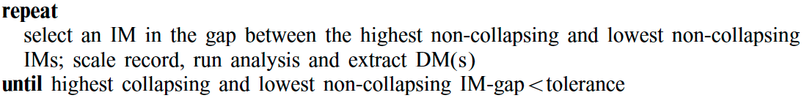
FILL PHASE –
CAPACITY RESOLUTION

Slide 39
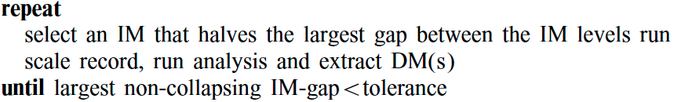
FILL PHASE –
DEMAND RESOLUTION

Slide 40
CONCLUSIONS
SINGLE IDA
MULTI-IDA
OTHERS
SOFTENS, SOFTENING & HARDENING, RESURRECTION, LIMIT-STATES
STATISTICS METHOD
PBEE FRAMEWORK
SCALING LEGITIMACY
NON-LINEAR SPO
IDA ALGORITHMS

Slide 41
Q&A
thorough understanding of the range of response or ‘demands’ versus the range of potential levels of a ground motion record

